Slide 1
ACP Invitational Joint Educators Meeting April 7-8, 2017 Chicago, IL
Promoting Excellence in Prosthodontic Education
Predoctoral Educator Meeting

Slide 2

Integration of 3D Printed Models and digital technology in Teaching Occlusion
Shereen S. Azer
BDS, MSc, MS
Associate Professor
Division of Restorative Science and Prosthodontics

Slide 3
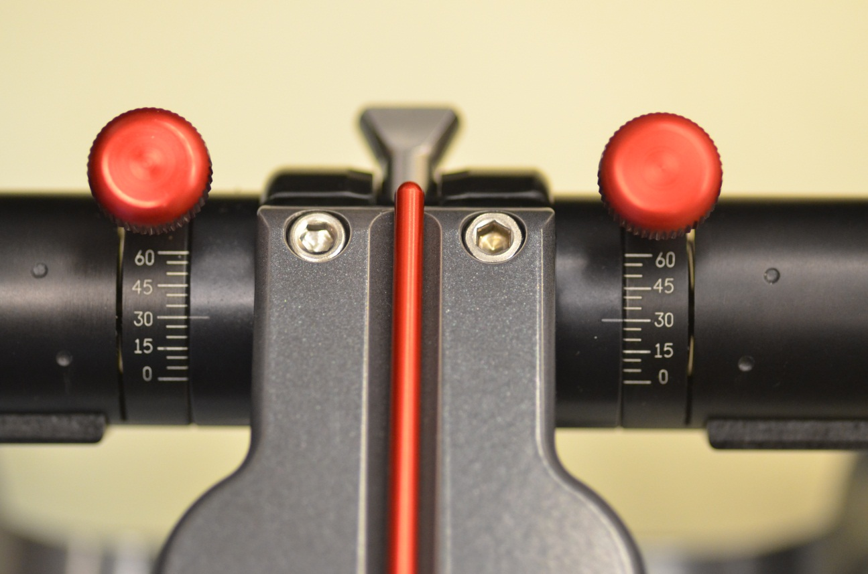
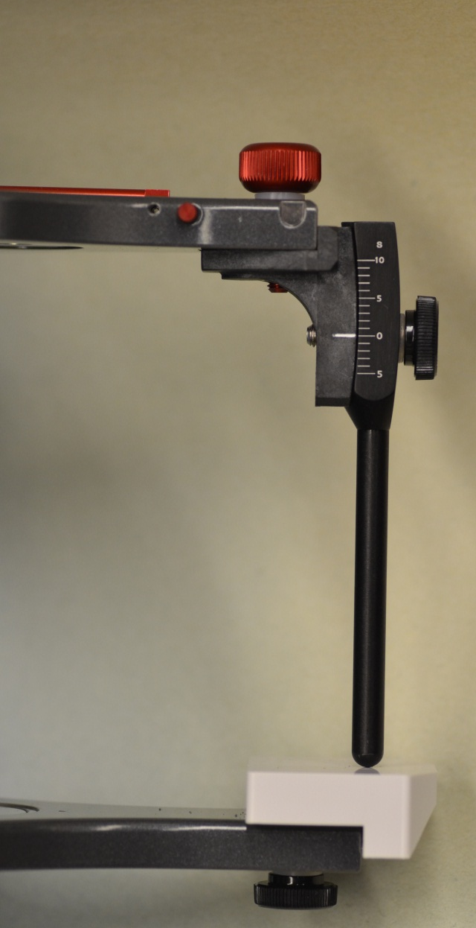
Denar “Mark 320” Articulator
Selected for DDS Students

Slide 4
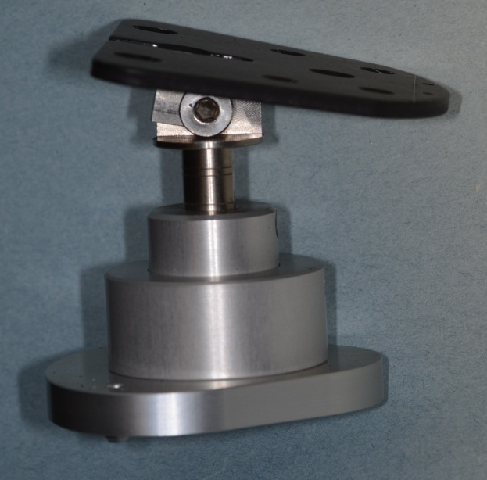
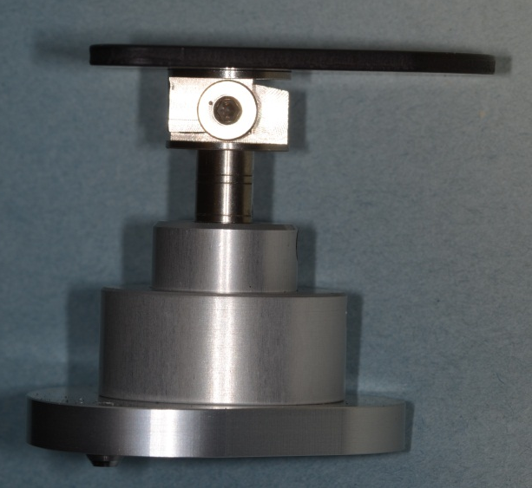
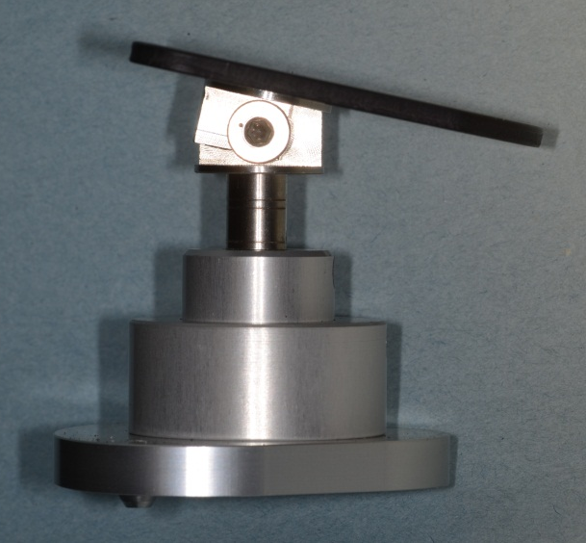
The Flat “Occlusal Stand”
0º Inclination
10º Inclination

Slide 5
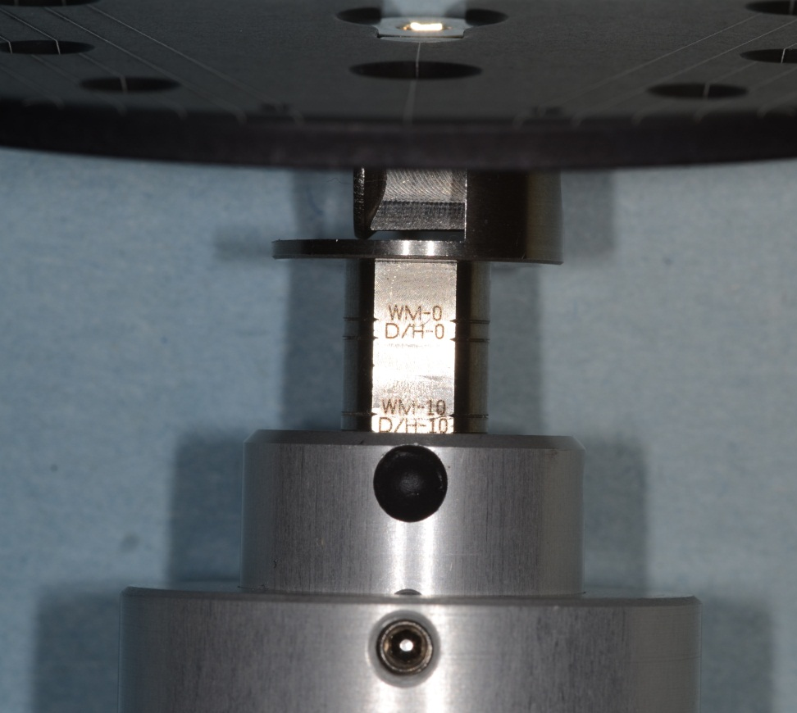
The Flat “Occlusal Stand”
Level the height at “D/H-10”

Slide 6
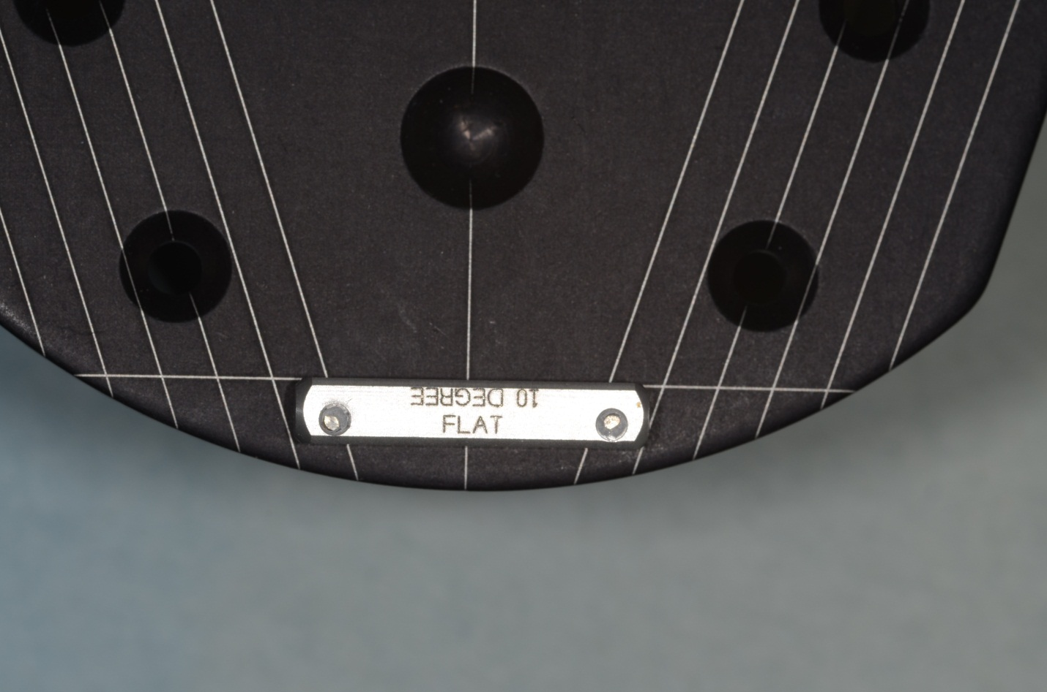
Application of the “Fence”

Slide 7
2 Courses combined moving away from typodonts
Waxing of Posterior Teeth
Waxing of Anterior Teeth

Slide 8
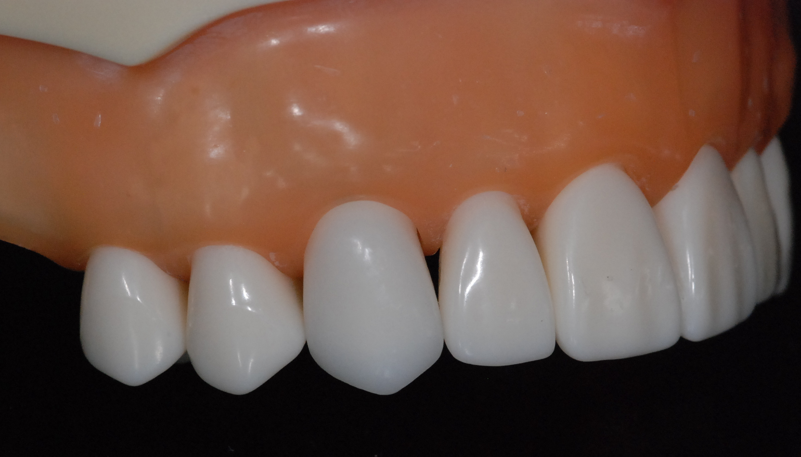
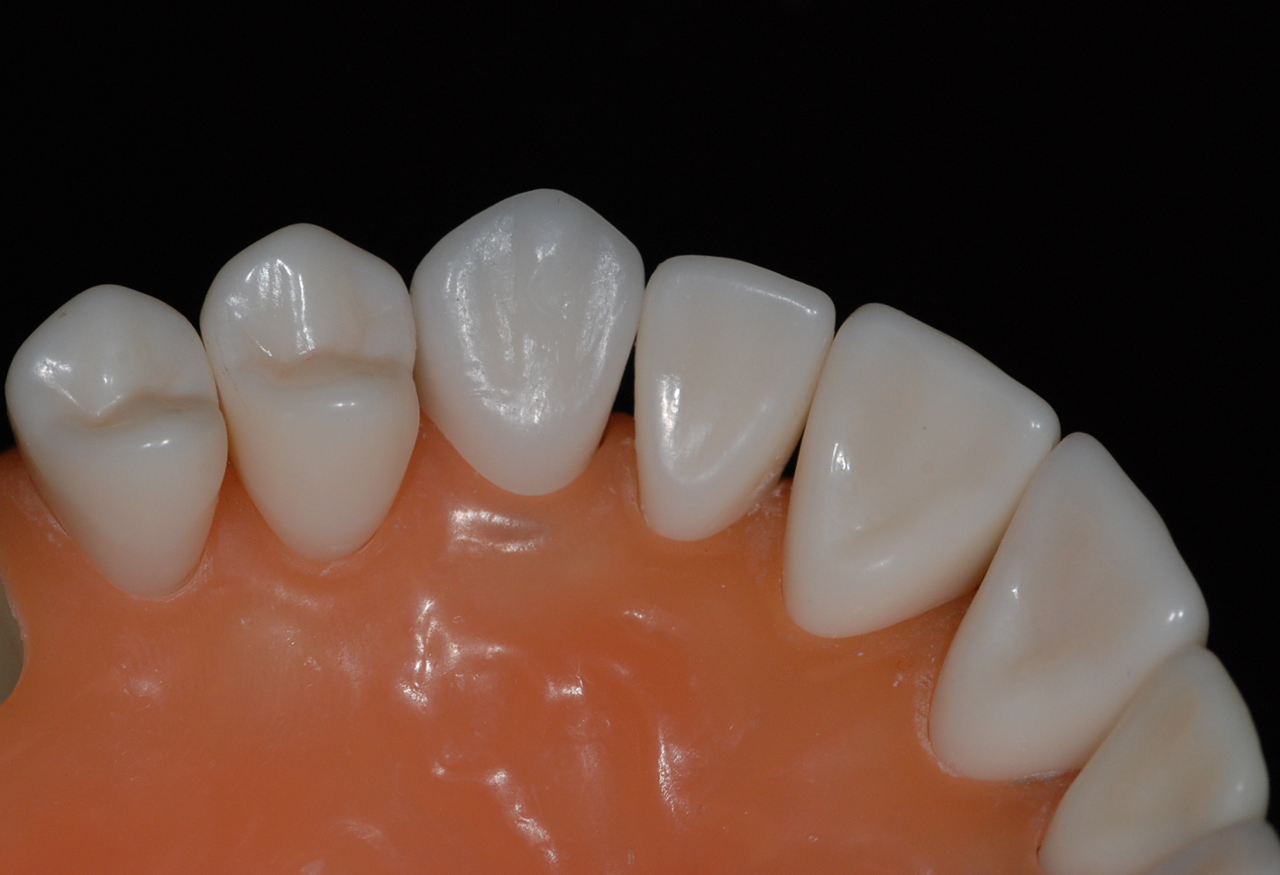
Typodont waxing of tooth #6

Slide 9
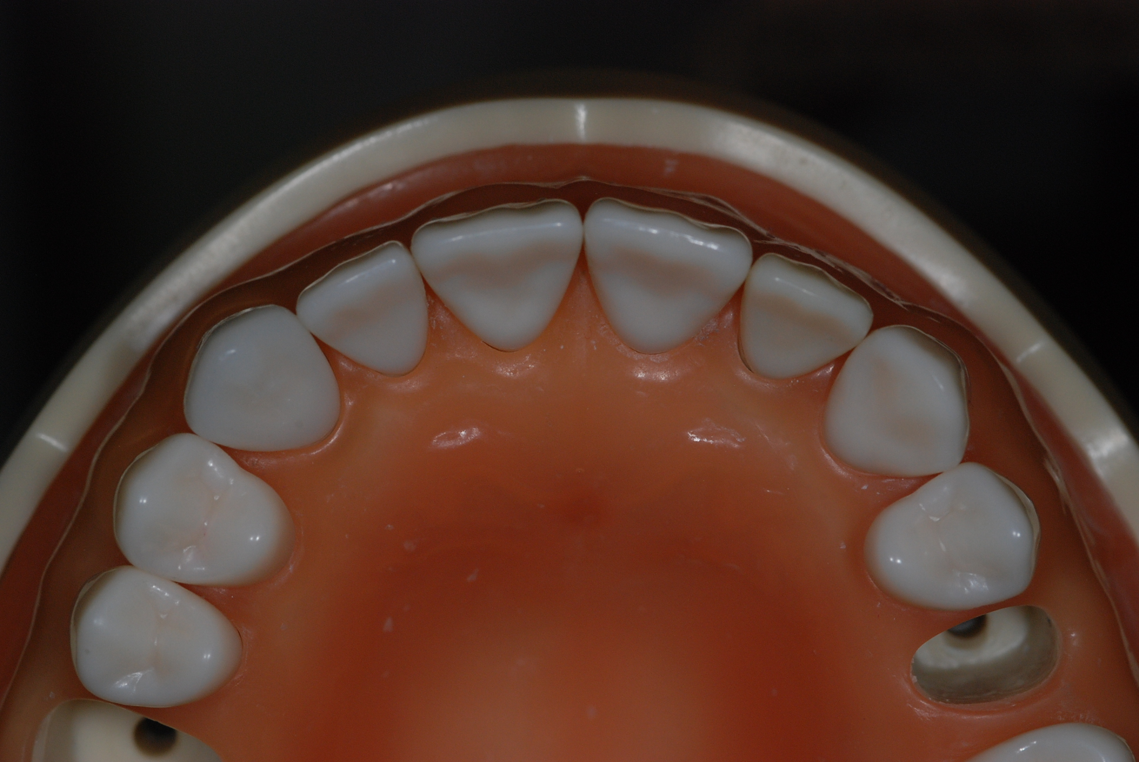
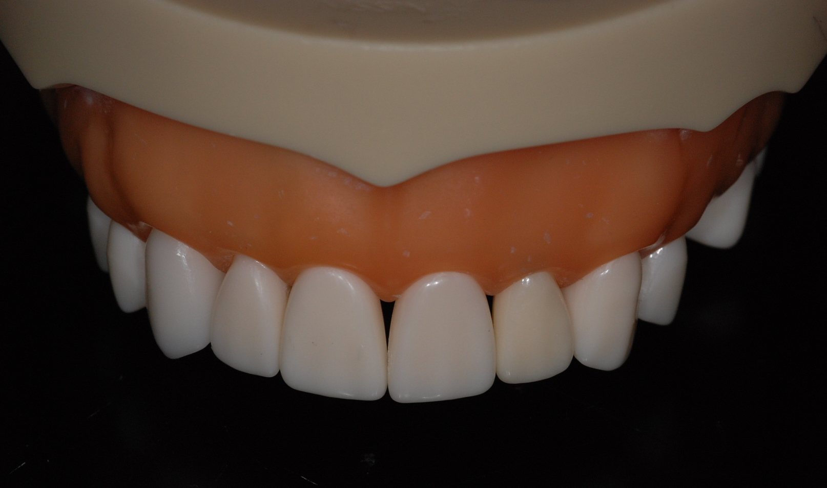
Typodont waxing of tooth #6

Slide 10
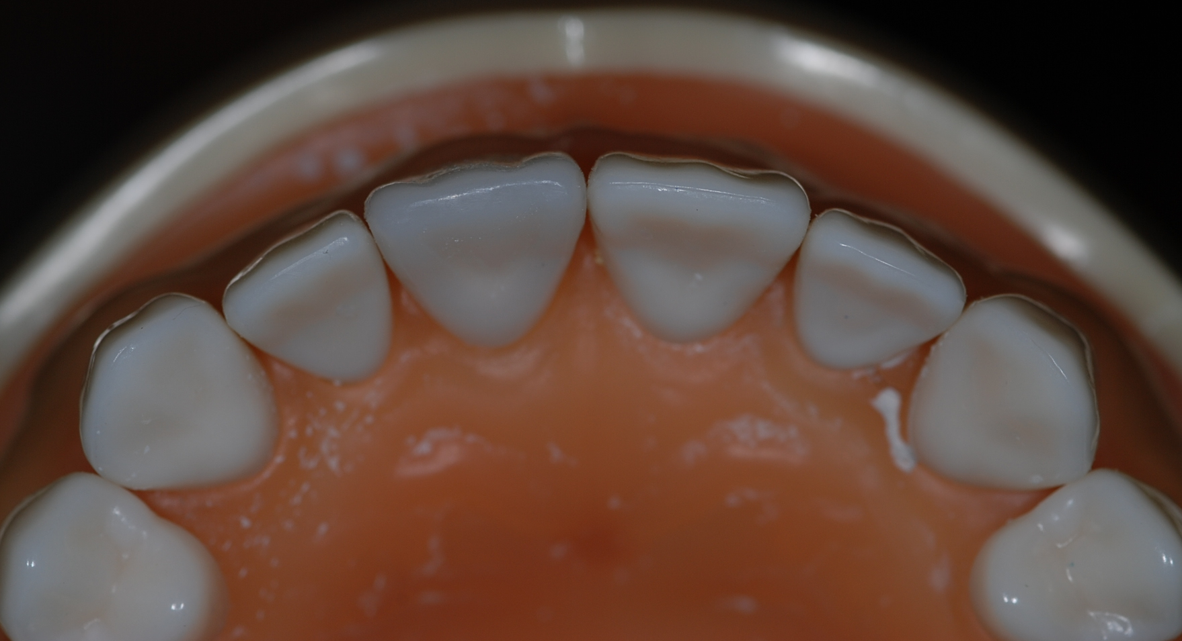
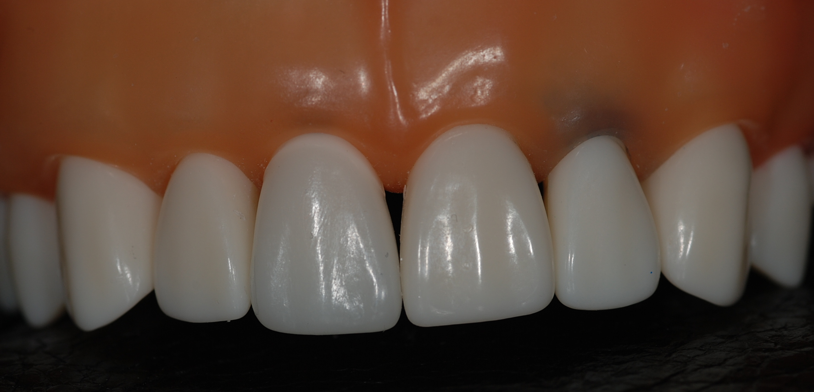
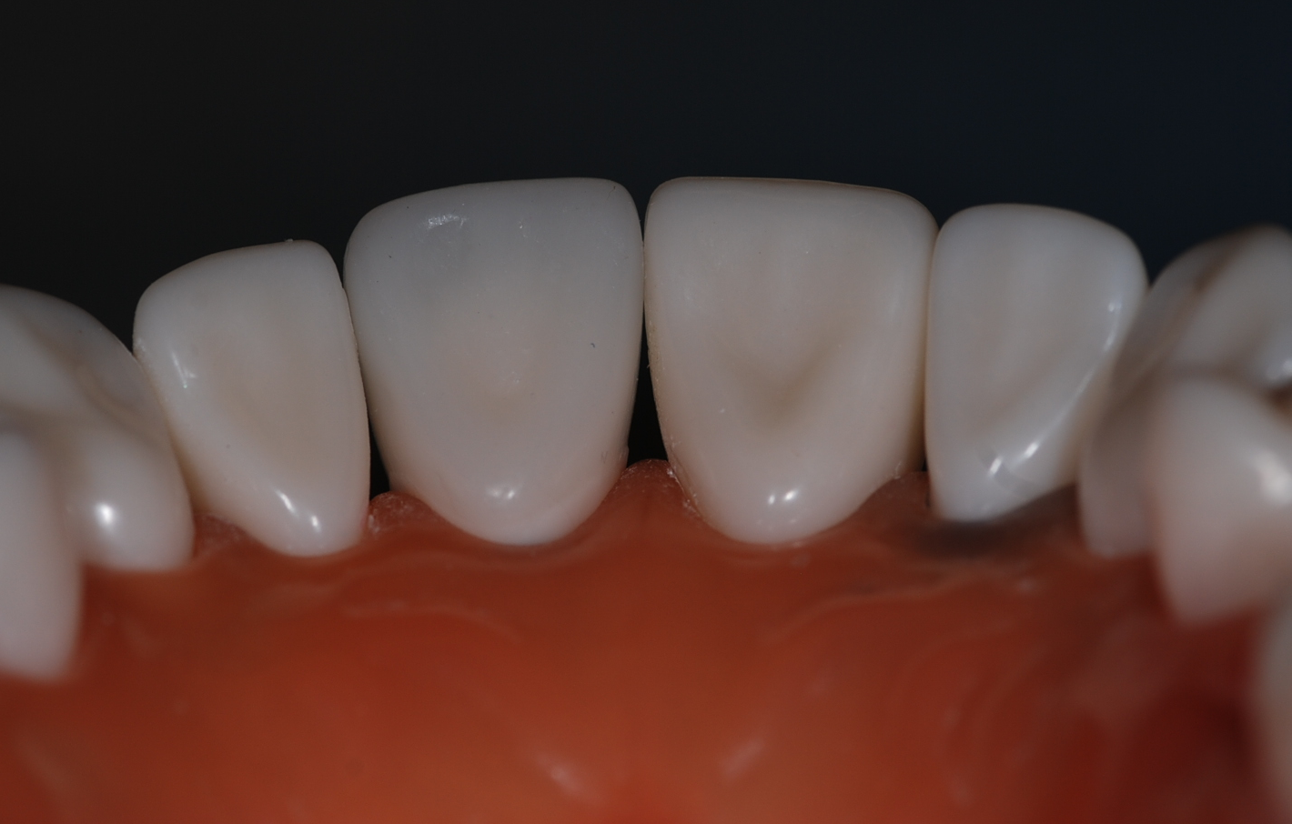
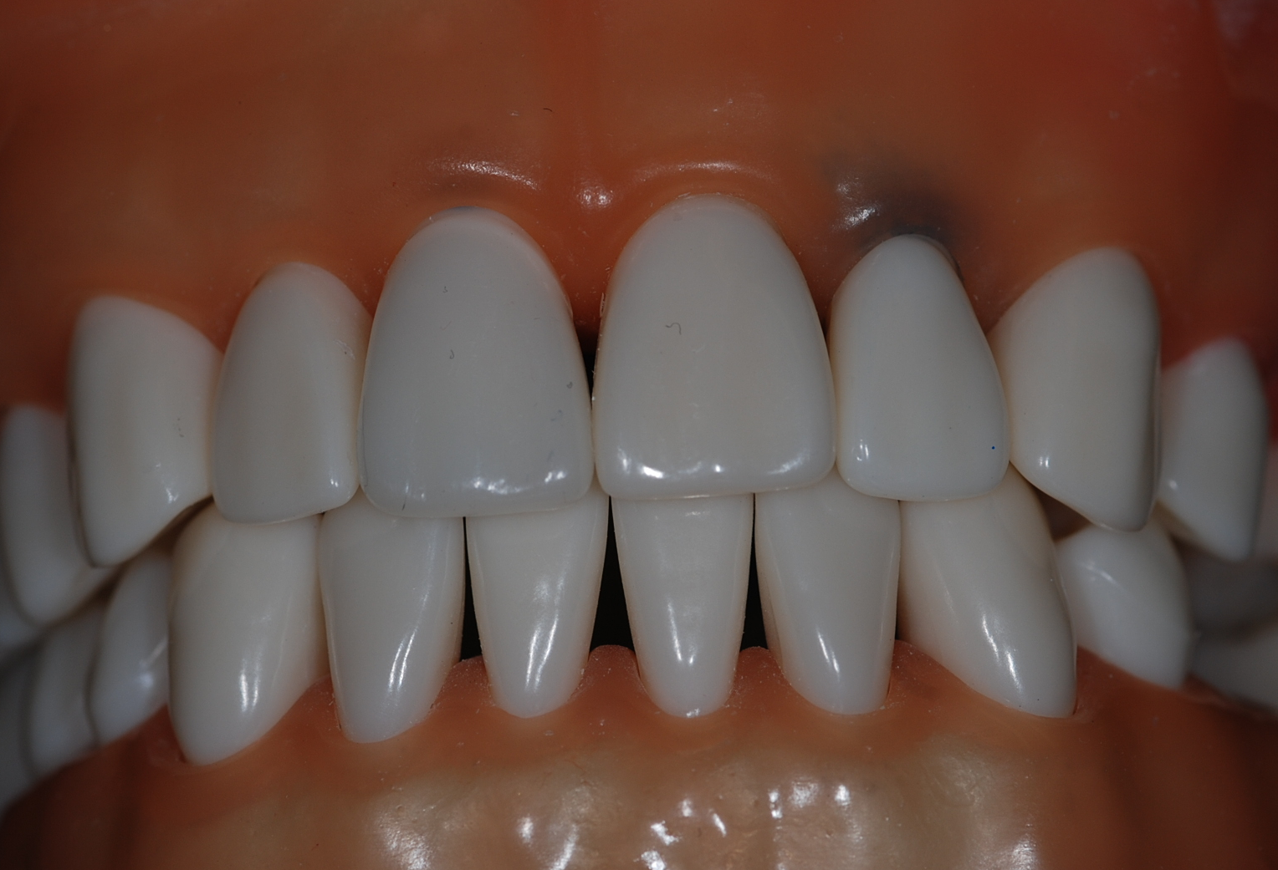
Typodont waxing of tooth #8

Slide 11
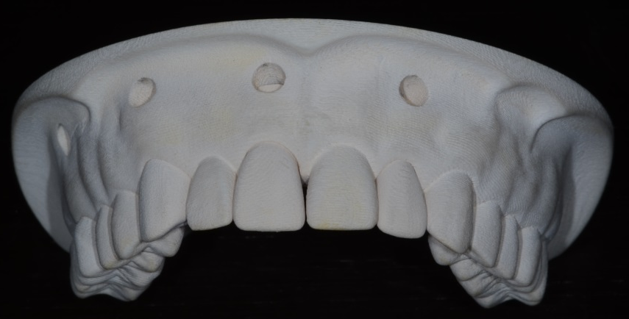
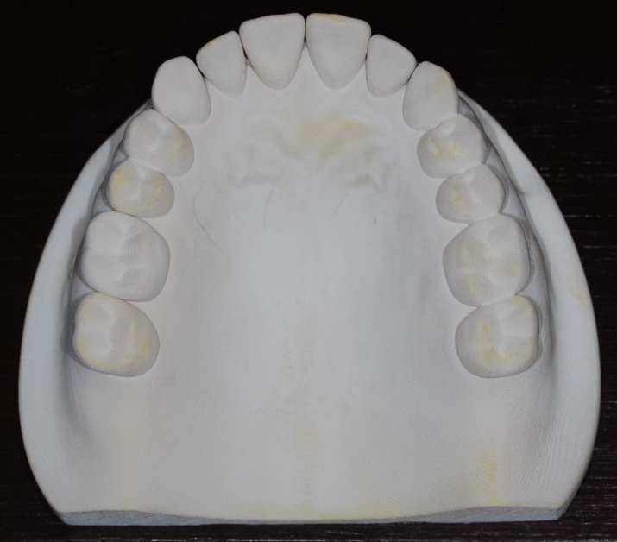
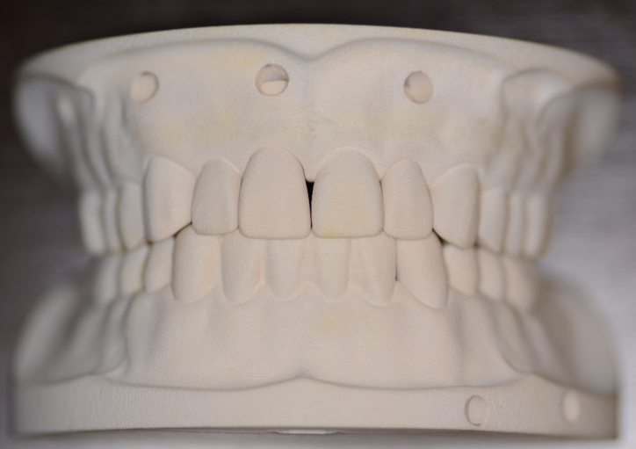
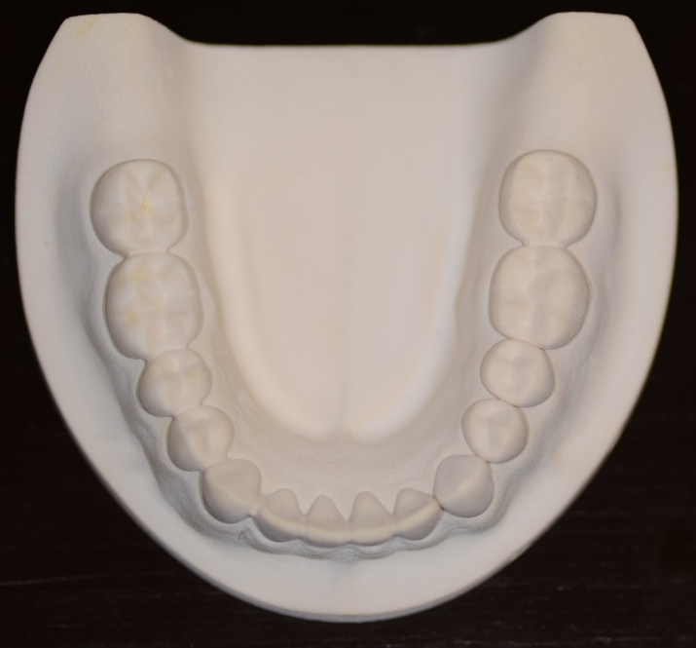
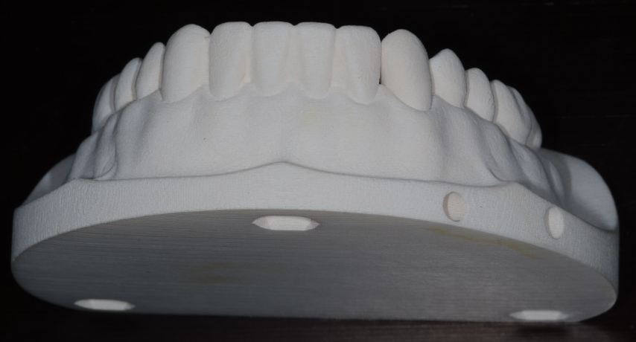
New Printed Models (Whip Mix Corp.)
“The OSU Model”
Removable Teeth/Dies

Slide 12
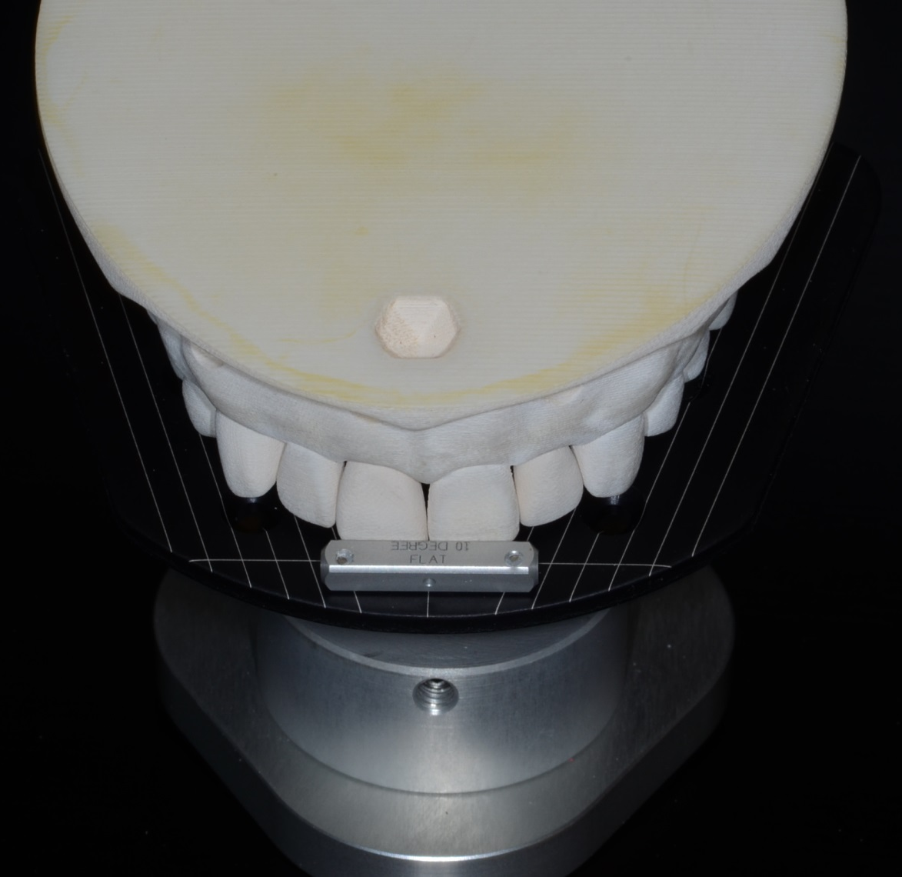
New Printed Models (Whip Mix Corp.)
“The OSU Model”

Slide 13
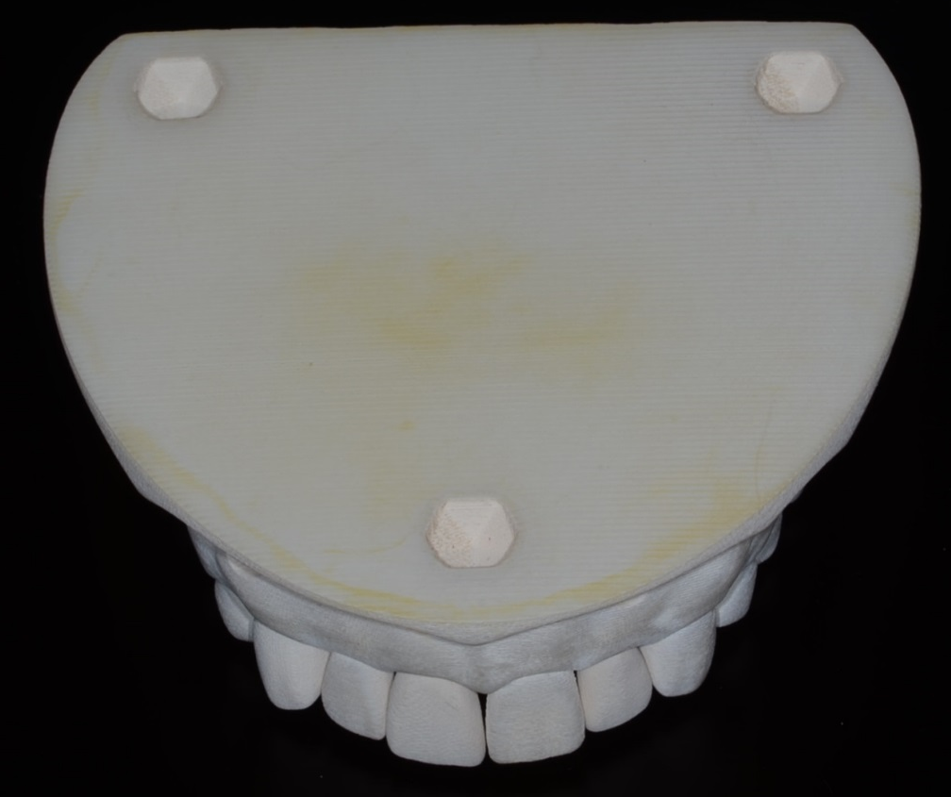
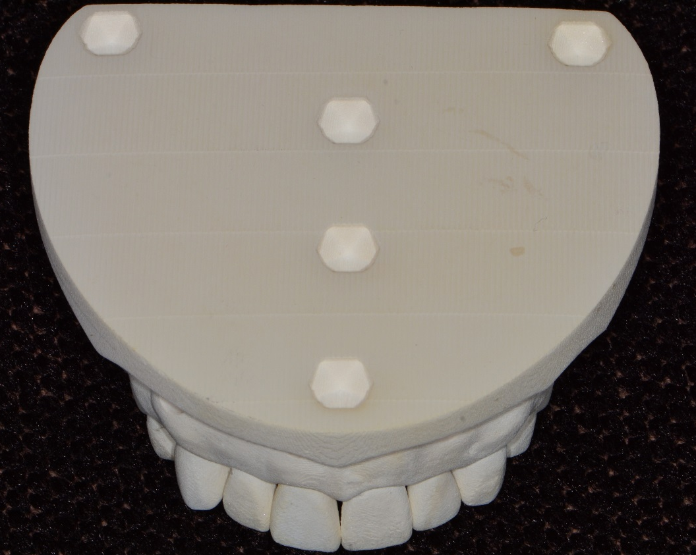
New Printed Models (Whip Mix Corp.)
“The OSU Model”
Addition of retentive features for 2-stage mounting

Slide 14
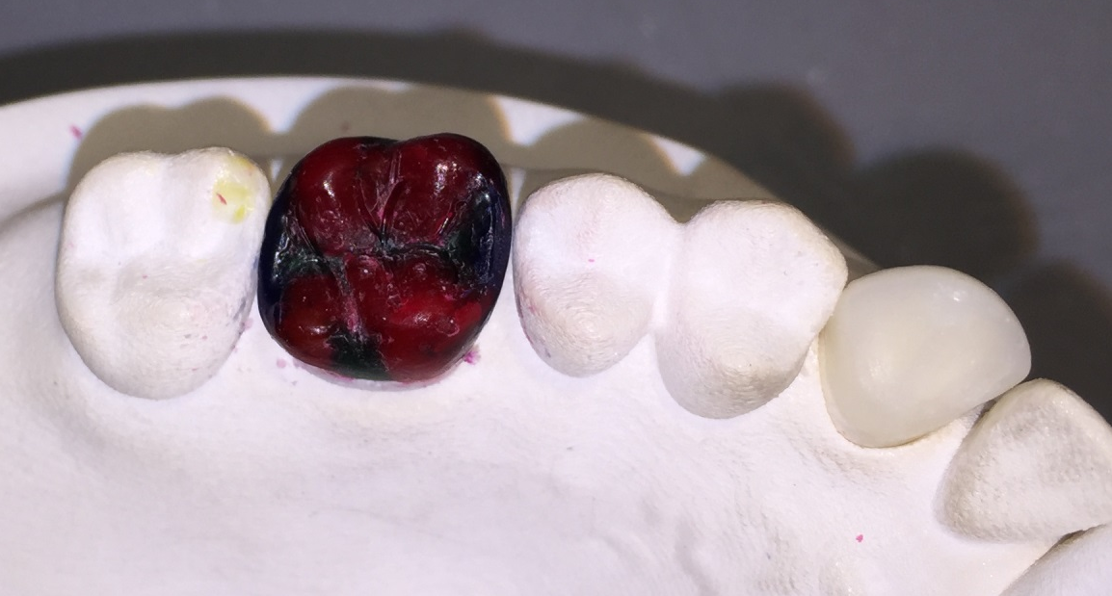
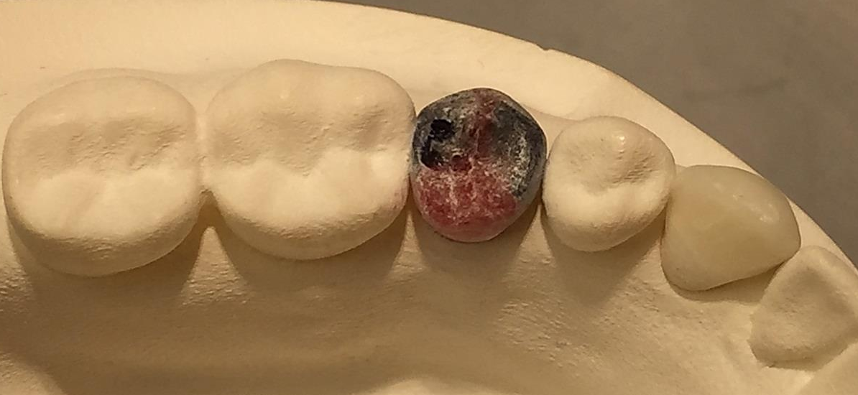
The Printed Models enabled developing functional tooth anatomy
Waxing of posterior teeth

Slide 15
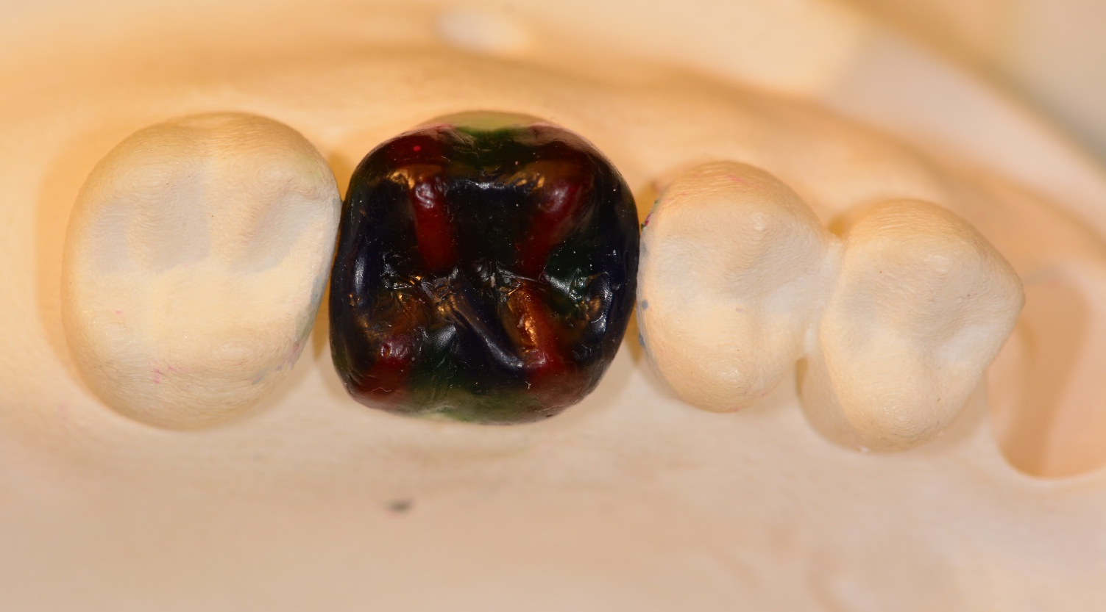
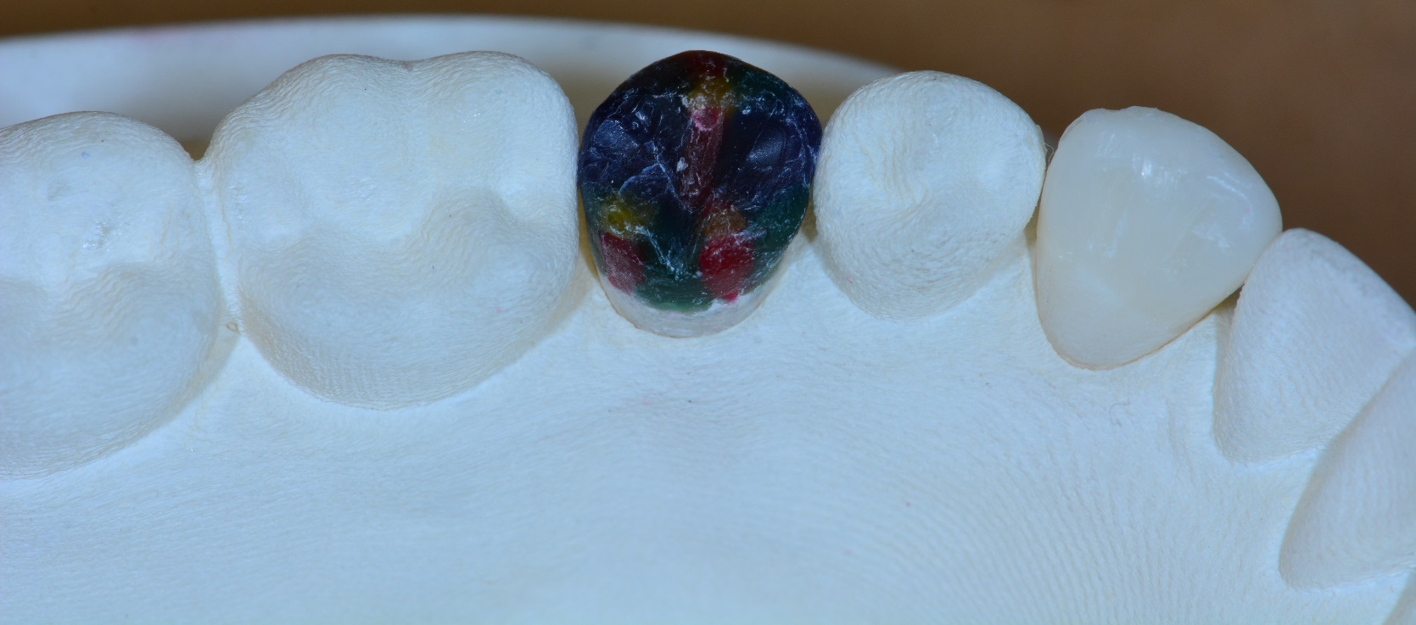

Slide 16
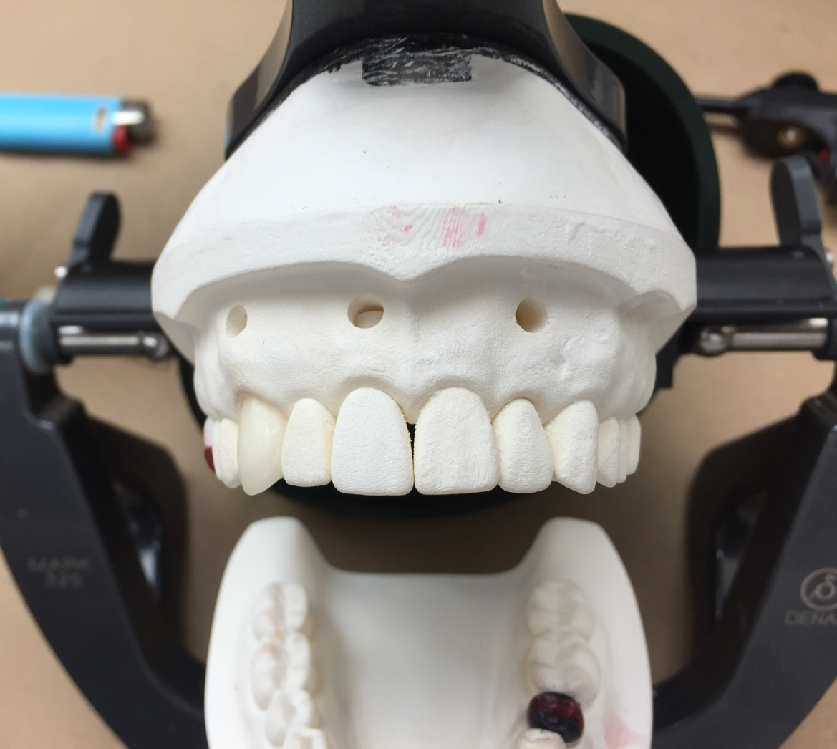
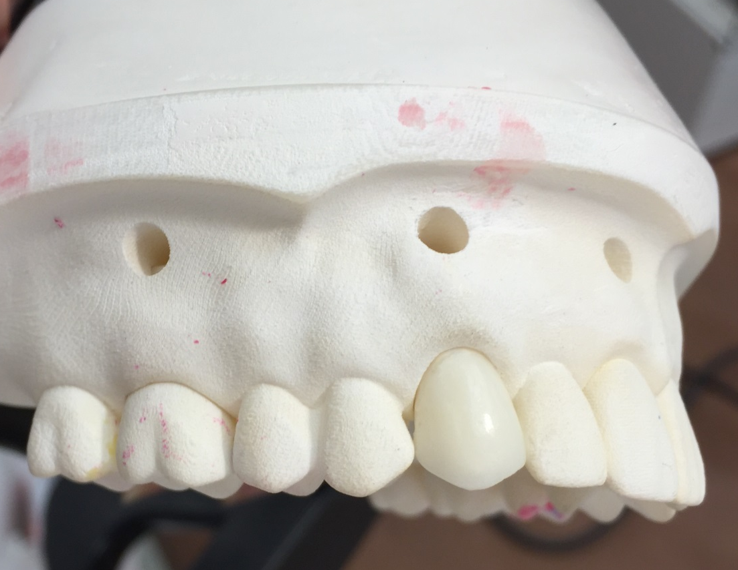
Waxing of tooth #6

Slide 17
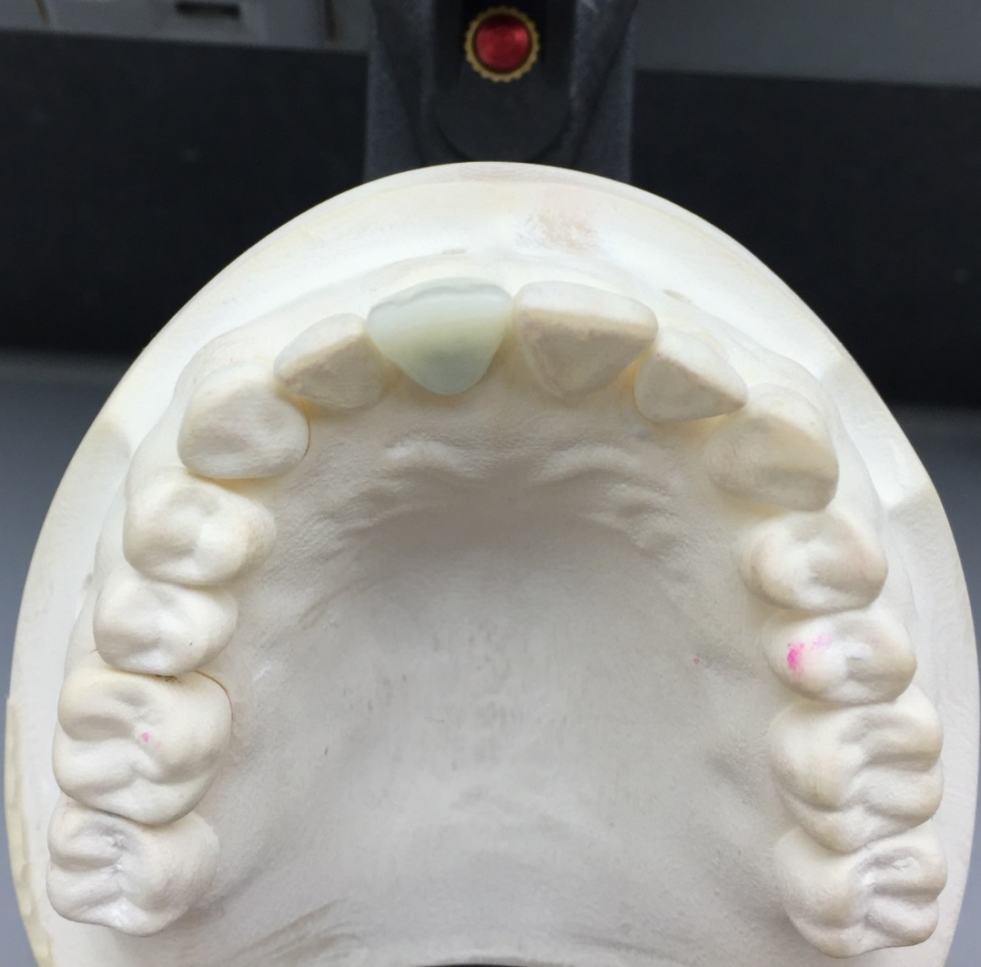
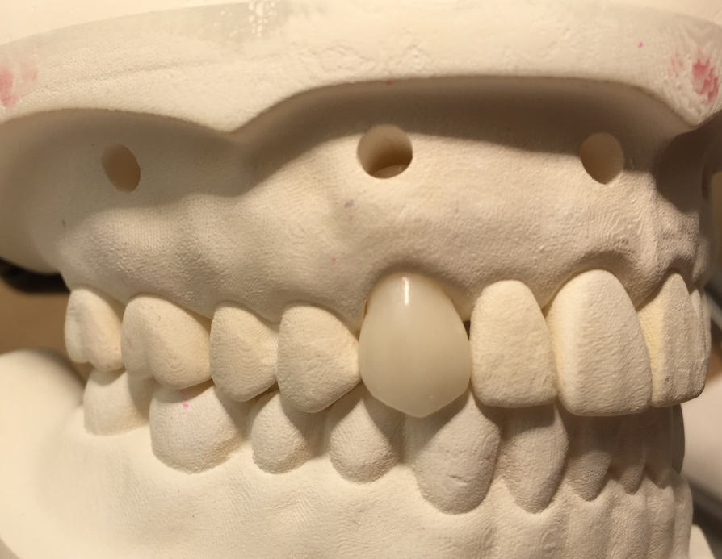
Waxing of tooth #6
Waxing of tooth #8

Slide 18
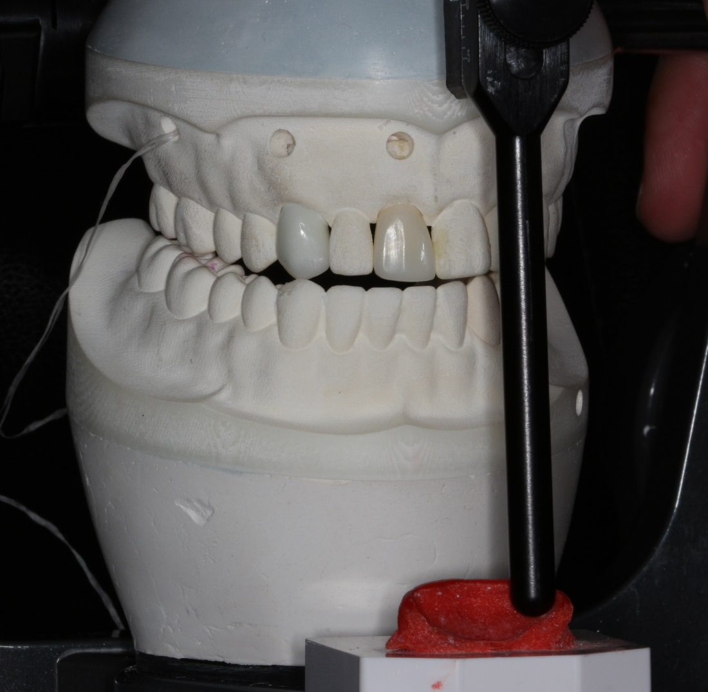
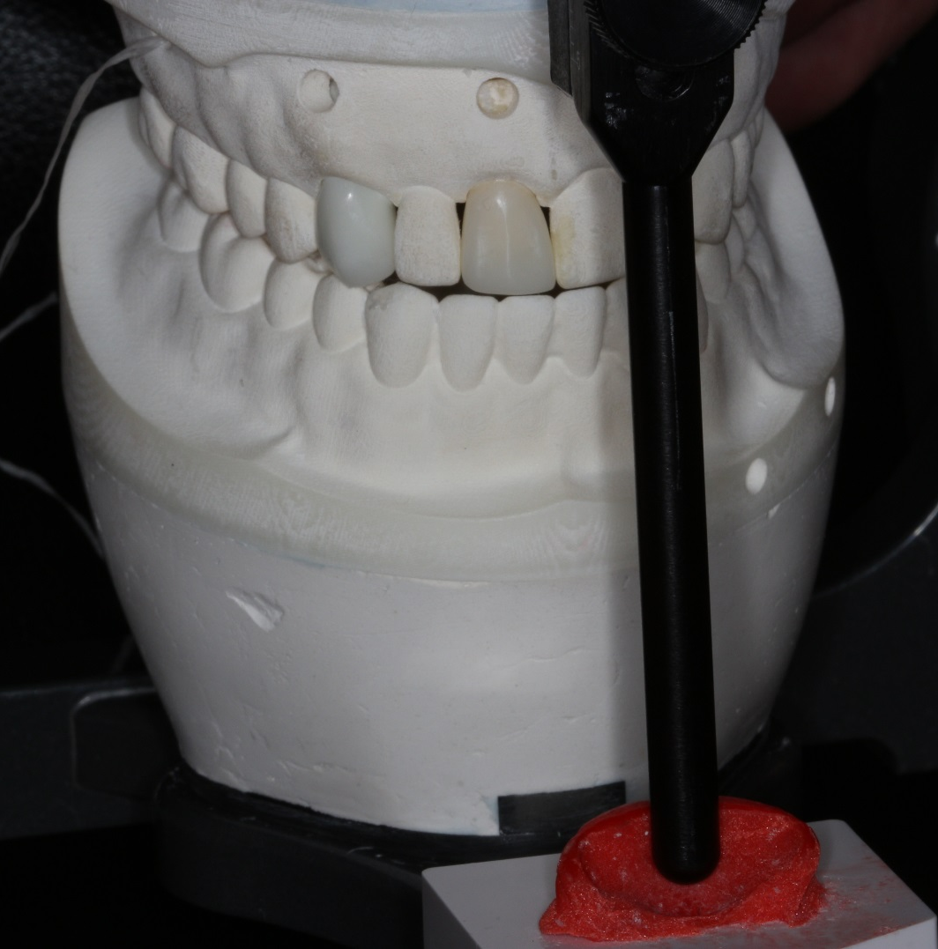
Developing Functional Anatomy
Printed models also enabled teaching the use of custom anterior guide table when developing tooth contours

Slide 19
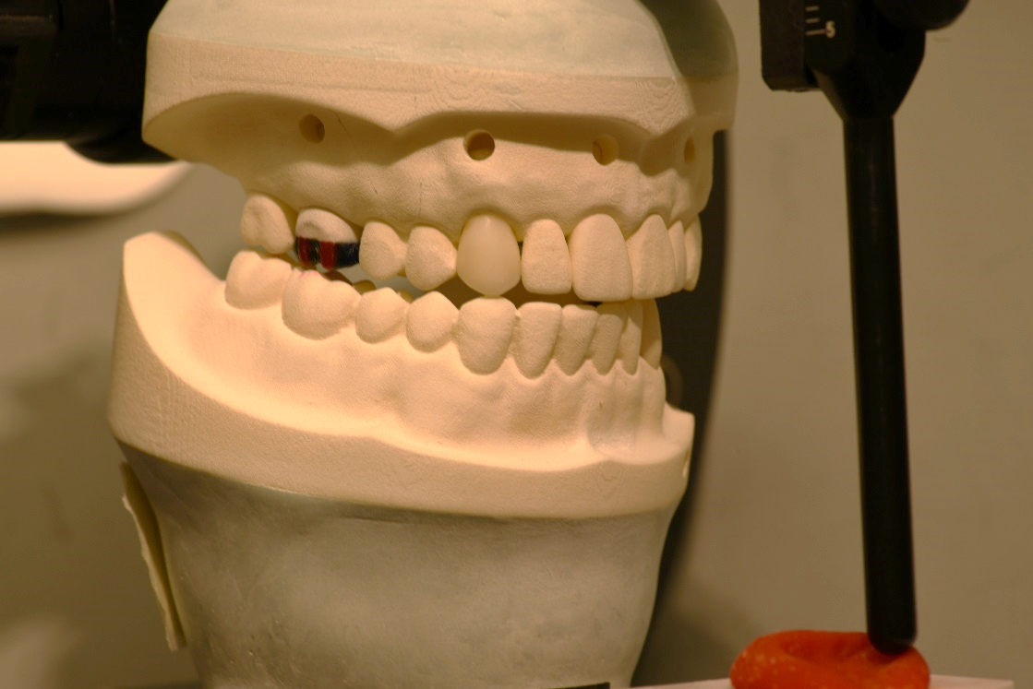
Advantages of the 3D printed models in Education
Flexibility of design and modifications
Fixed or removable dies (3-color options)
File storage for future print runs
Less discrepancy between students’ models
All preclinical lab
assignments can be
completed onto
the same articulator

Slide 20
Implementing the “Integrated Curriculum” between preclinical and clinical courses for D1 Students
Alginate impressions
Own cast fabrication
Earbow transfer
Centric relation records
Mounting own casts
Locating CO/MIP slide
Occlusal equilibration of own casts

Slide 21
Thank you for your kind attention
azer.1@osu.edu

